Slide 1
Lecture 22: Interpretation of Prediction Models

Slide 2
ANNOUNCEMENTS
Homework 7 OH:
For conceptual questions: Faculty will continue their office hours.
If you have problems with TensorFlow please let us know on ED. We will arrange special OH to help if necessary.
Project:
Milestone3 due today. EDA and base model. Talk to your assigned TF!
AC 209A
Advanced Section today.

Slide 3
Outline
Variable Importance
Interpretation through Predictions
Adding Uncertainty

Slide 4
Variable Importance

Slide 5
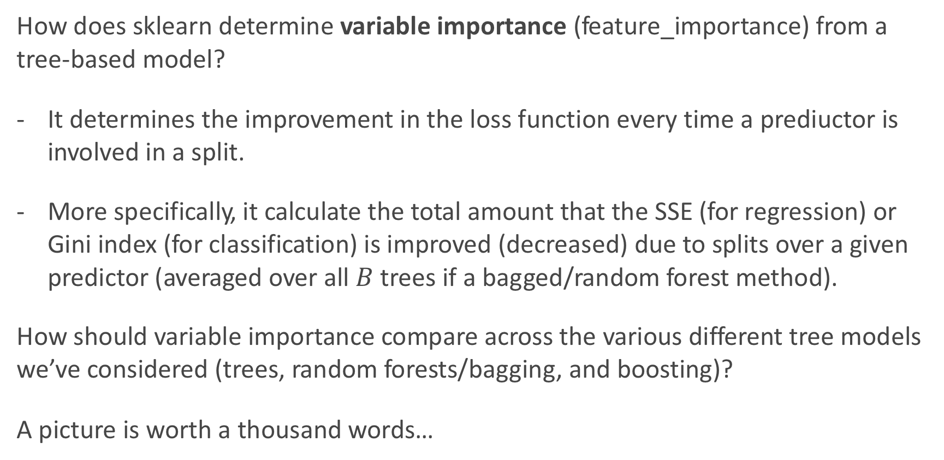
Variable Importance for Tree-Based Models
How does sklearn determine variable importance (feature_importance) from a tree-based model?
It determines the improvement in the loss function every time a prediuctor is involved in a split.
More specifically, it calculate the total amount that the SSE (for regression) or Gini index (for classification) is improved (decreased) due to splits over a given predictor (averaged over all $B$ trees if a bagged/random forest method).
How should variable importance compare across the various different tree models we’ve considered (trees, random forests/bagging, and boosting)?
A picture is worth a thousand words…

Slide 6
Variable Importance for trees, bags, and boosts
Below are the variable importance plots for the top 10 predictors for each of a (i) decision tree with maxdepth=3, (ii) decision tree with maxdepth=10, (iii) a random forest, and (iv) an adaboost classifier.
Compare them? Are the differences surprising?

Slide 7
Feature Importance in a Neural Network
How can one measure feature importance in a Neural Network?
Its not so easy ☹. What could potentially be done?
We can calculate the predictions from a neural net, and then fit a decision tree model to the predicted values.
What can go wrong with this approach?

Slide 8
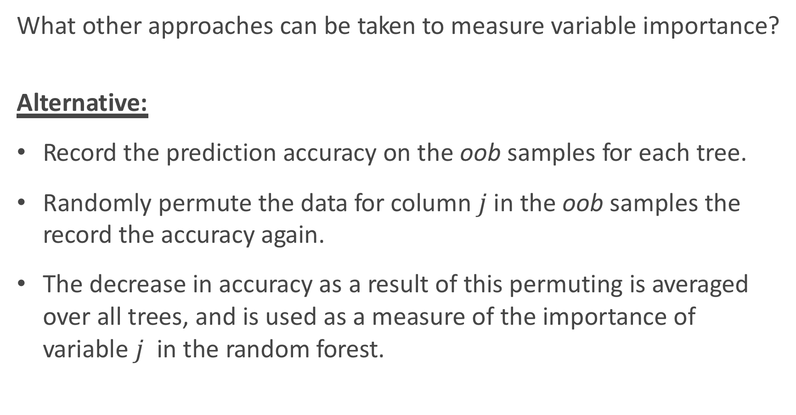
Other Variable Importance Measures
What other approaches can be taken to measure variable importance?
Alternative:
Record the prediction accuracy on the oob samples for each tree.
Randomly permute the data for column $j$in the oob samples the record the accuracy again.
The decrease in accuracy as a result of this permuting is averaged over all trees, and is used as a measure of the importance of variable $j$ in the random forest.

Slide 9
Permutation Variable Importance
This idea of re-permuting a variable and refitting a model to see how much more poorly it performs is called permutation feature importance.
It is sometimes preferred to the standard feature importance, why?
When two features are correlated and one of the features is permuted, the model will still have access to the feature through its correlated feature.
What is the one glaring disadvantage to this?
Computational time, and things may not ‘add up’.

Slide 10
Permutation Variable Importance in sklearn
To perform permutation variable importance in sklearn (or keras), one can use the ELI5 library:
https://eli5.readthedocs.io/en/latest/index.html
This is easy to do with sklearn models, but not easy to do with tensorflow (but it can be done).
An example is worth a thousand words:

Slide 11
Permutation Variable Importance Example

Slide 12
The problem with Variable Importance
Variable Importance is great! It tells you what features are important in shaping the model.
But what is missing?
It does not give any measure for how the predictors are related to the response (positive, negative, quasi-linear, curved, interactions, etc.).
This is where the parametric model wins out! Inference and interpretations are much easier and the whole point in these models.
What can we do to measure these relationships in a machine learning or non-parametric model? Think: what did we do with k-NN?
What needs to be done algorithmically to put this in practice?

Slide 14
Interpretation through Predictions

Slide 15
Parametric vs. Nonparametric models
In a machine learning model (like ensemble methods and neural networks), the association between predictors and the response are not measured directly as these models are ‘black box’ models:
Inputs (X, predictors). → black box (NN, sklearn, etc.) → Outputs (Y, response)
What if we care about how the predictors relate to the response? This is where we need to figure out what the black box is doing to transform the inputs into the outputs.

Slide 16
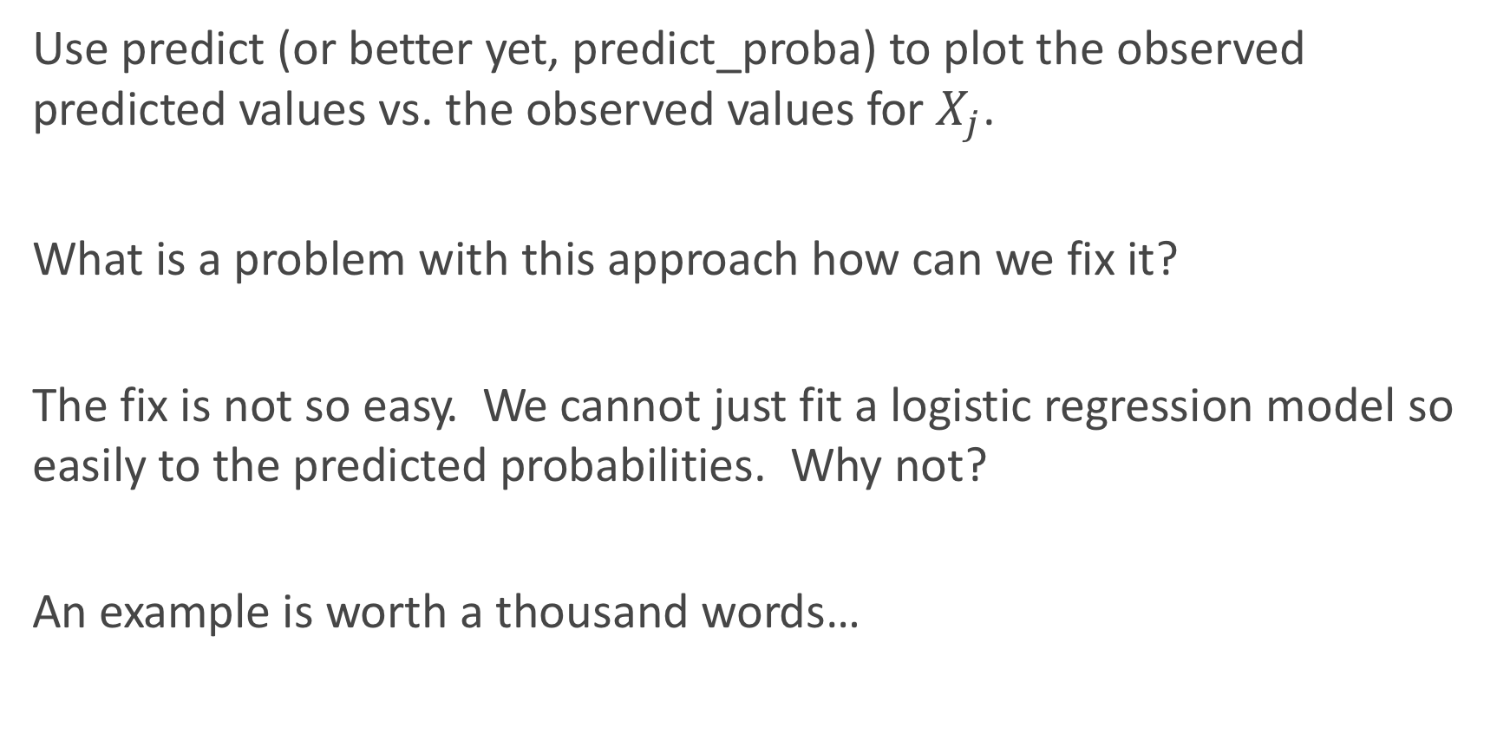
Simplest Approach: observed $\hat{Y}$ vs. $X_{j}$
Use predict (or better yet, predict_proba) to plot the observed predicted values vs. the observed values for $X_{j}$.
What is a problem with this approach how can we fix it?
The fix is not so easy. We cannot just fit a logistic regression model so easily to the predicted probabilities. Why not?
An example is worth a thousand words…

Slide 17
Example: observed $\hat{Y}$ vs. $X_{j}$

Slide 18
Unboxing the black box
Inputs (X, predictors). → black box (NN, sklearn, etc.) → Outputs (Y, response)
This gives us our approach: vary the inputs (the predictors) and see what happens to the response.
If we care about the ‘marginal’ or ‘conditional’ effect of how a specific X relates to Y, then we should vary only one predictor at a time.
How should we handle the other predictors? That is to say, what value should we keep them at?

Slide 19
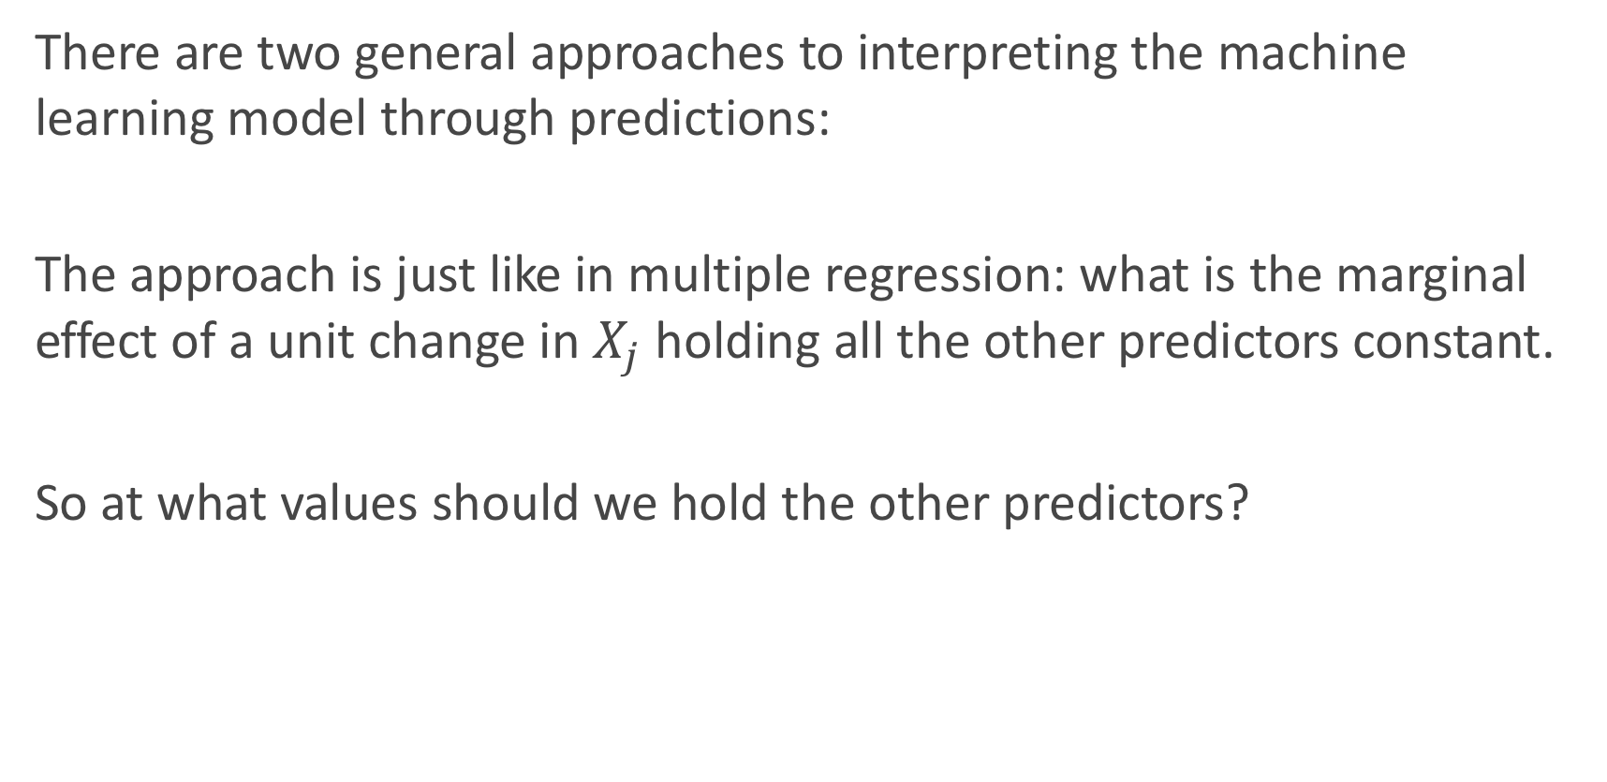
Unboxing the black box (cont.)
There are two general approaches to interpreting the machine learning model through predictions:
The approach is just like in multiple regression: what is the marginal effect of a unit change in $X_{j}$ holding all the other predictors constant.
So at what values should we hold the other predictors?

Slide 20
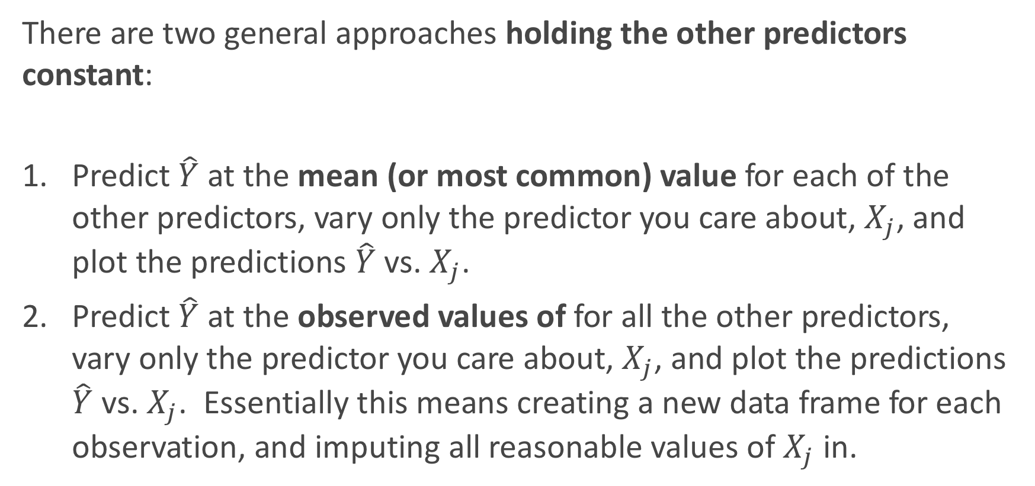
There are two general approaches holding the other predictors constant:
Predict $\hat{Y}$ at the mean (or most common) value for each of the other predictors, vary only the predictor you care about, $X_{j}$, and plot the predictions $\hat{Y}$ vs. $X_{j}$.
Predict $\hat{Y}$ at the observed values of for all the other predictors, vary only the predictor you care about, $X_{j}$, and plot the predictions $\hat{Y}$ vs. $X_{j}$. Essentially this means creating a new data frame for each observation, and imputing all reasonable values of $X_{j}$ in.

Slide 21
Predicted probabilities vs. Age at the means
Interpret this plot. What does this say for how Cardiac Arrest is associated with Age?

Slide 22
Predicted probabilities vs. Age for all observations
Interpret this plot. What does this say for how Cardiac Arrest is associated with Age?

Slide 23
What if we want the joint relationship with two predictors?
How can we look at how the response relates to two predictors at once?
This is a bit trickier to do. Why?
We can go back to our friend: the classification boundary!

Slide 24
What if we want the joint relationship with two predictors?

Slide 25
Should I use PCA components?
What if we want an overall picture of how the response relates to the predictors?
Well, this is where PCA components sometimes come in to play.
But this is no Bueno for interpretability. Why?

Slide 26
Adding Uncertainty

Slide 27
Adding Uncertainty
Not only should we plot predictions, but we can (should) also include the uncertainty of these predictions.
For example, there may be a big difference between.
How can we add uncertainty measures to these predictions? How do we do it for linear/logistic regression?
Boostrapping

Slide 29
Bootstrapping Basics, review
How do we perform a bootstrap? What are the key steps?
The bootstrap algorithm is an approach to mimic the uncertainty of taking the observed sample from a population. So we:
Sample the same number of observations as was observed (in train).
Sample with replacement (so we get some randomness).
Why does this work?

Slide 30
Bootstrapping Basics, review
When is a bootstrapping approach used?
When a probabilistic closed form solution is not known or not easy to get at.
When the assumptions for a parametric model break down.
When there is no ‘formula’ at all to add the uncertainty into a calculation.
Or we are just being lazy.

Slide 31
Bootstrapping Basics, review
How do we use the results of a bootstrap technique?
It provides us a re-created estimate every time we bootstrap.
This estimate could be a mean, a beta, a plot of average predictions, etc.
But they will almost always be for a summary, not a single observation, and thus the sample size is already taken care of (the n in the formula). Aka, do not divide by sqrt(n) again!

Slide 32
Bootstrapping for Predictions
So we can refit a model on a bootstrap sample of data, and look at the predicted probabilities each time.
Then we can take the top 97.5th percentile and bottom 2.5th percentile to build a 95% confidence interval for the predictions!
But how does this work for random forests and bagging models? Yikes!

